Slide 1
R B Tree

Slide 2
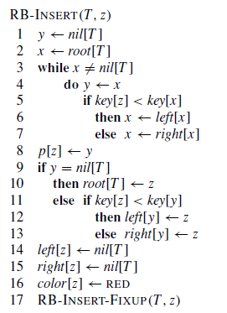
Insertion of a node in RB tree

Slide 3
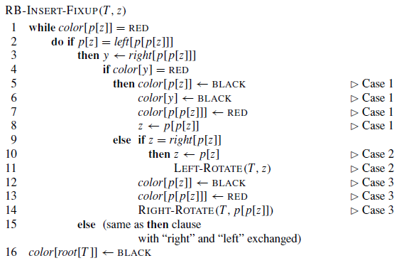
Maintaining R B Tree properties after Insertion

Slide 4
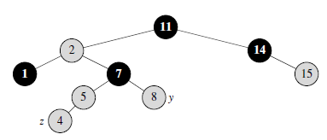
Example of insertion: Let z is the newly inserted node

Slide 5
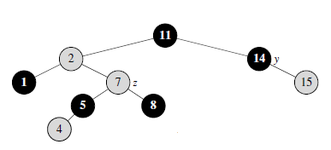
Example of insertion: Let z is the newly inserted node…

Slide 6
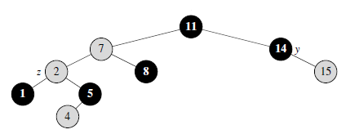
Example of insertion: Let z is the newly inserted node…

Slide 7
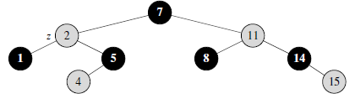
Example of insertion: Let z is the newly inserted node…

Slide 8
Example
Consider a initially empty R B tree and insert following nodes “15, 11, 35, 25, 45, 44, 21, 65, 71, 66” in the tree.

Slide 9
Cases of Insertion
For cases 1, 2 & 3 parent[z] is left child of its parent.
Case 1: Color of y (z’s uncle) is red
Work: make z’s father’s and uncle’s color black, grandfather’s color red and grandfather becomes new z. and continue while loop.

Slide 10
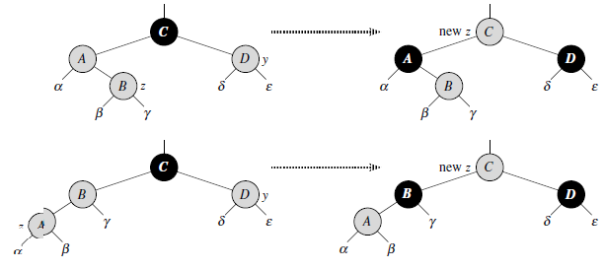
Case 1

Slide 11
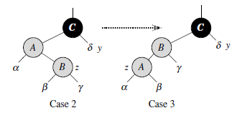
Case 2
Case2: z’s uncle y’s color is black and z is right child of its parent.
Work: parent of z become new z and then left rotate on this new z. Now this case is converted into case 3.

Slide 12
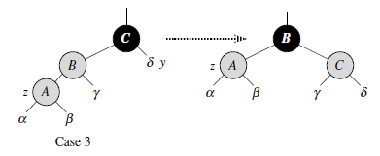
Case 3
Case 3: z’s uncle, y’s color is black and z is left child of its parent.
Work: make z’s parent color black and z’s grandparent's color red and then right rotate on the grandparent of z.

Slide 13
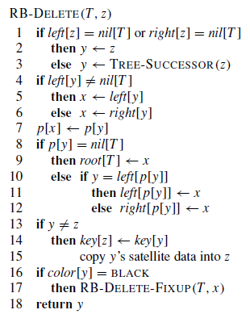
Deletion of a node in R B tree

Slide 14
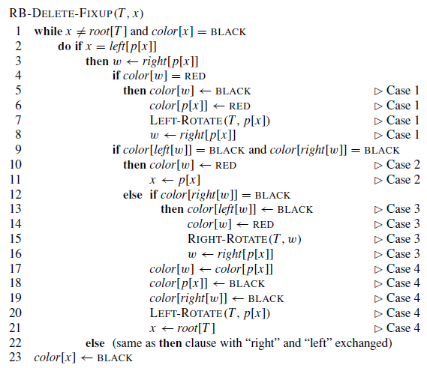
Maintaining R B Tree properties after Deletion

Slide 15
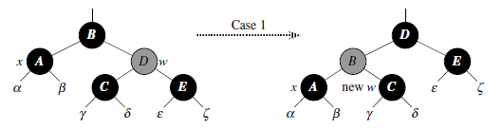
Cases of Deletion
Case 1: x’s sibling w has color red
Work: make w’s color black, make parent[x] color red, left rotate on parent[x] and then make right[p[x]] new w.
Now case 1 is transformed to case 2, 3, or 4.

Slide 16
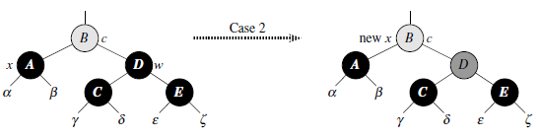
Cases of Deletion
Case 2: x’s sibling w has color black and both its children have color black.
Work: make w’s color red . Parent[x] will become new x and after that continue while loop.

Slide 17
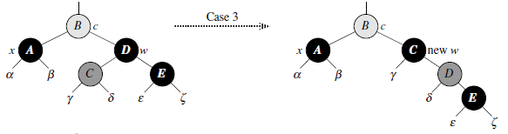
Cases of deletion
Case 3: x’s sibling w has color black, w’s left child is red and w’s right child is black.
Work: make w’s left child’s color black, make w’s color red. Right rotate on w and then new w will be right child of parent[x].
Now case 3 is converted into case 4.

Slide 18
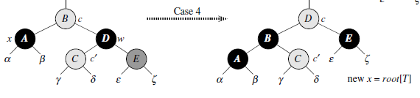
Cases of deletion
Case 4: x’s sibling w has color black and w’s right child is red.
Work: color of parent[x] will be assigned to w. Make color of parent[x] black, make color of right child of w Black, left rotate on parent[x] and make root of the tree as new x.

